Slide 1
Filesystem Project Design, Implementation, Testing, and Evaluation
Name: Brayan Andres Salinas Giraldo
Student Number: M00857810

Slide 2
Project description
This project involves the development of a lightweight filesystem designed for embedded systems. The filesystem supports basic file operations such as creation, reading, writing, and deletion of files.“
The filesystem project aims to create a simple and efficient file management system for embedded systems. It is designed to be portable and uses standard C++ libraries to ensure compatibility across different platforms.

Slide 3
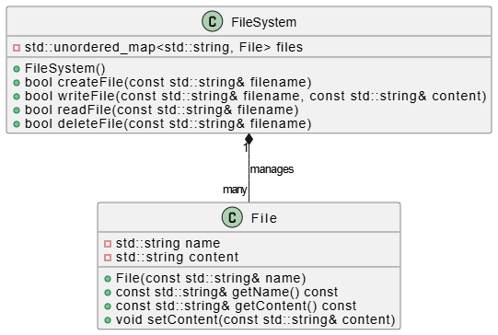
Class diagram

Slide 4
Description
The class diagram illustrates the structure of your filesystem project. It consists of two main classes: File: Represents a file with attributes name and content. Methods include constructors, getters for name and content, and a setter for content. Filesystem: Manages a collection of File objects using an unordered map (std::unordered map). Methods include constructors and functions for creating, writing, reading, and deleting files.
This diagram shows the structure of your filesystem project in terms of classes (File and FileSystem), their attributes, methods, and the relationship (manages) between FileSystem and multiple File objects.

Slide 5
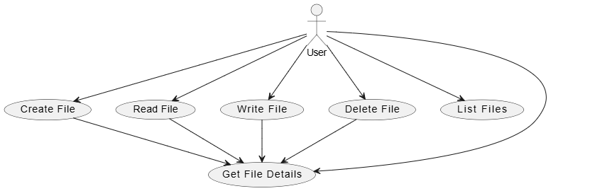
Use case diagram

Slide 6
Description:
The use case diagram depicts interactions between the User and the filesystem. It outlines various operations (Create File, Read File, Write File, Delete File, List Files, Get File Details) that the user can perform. Each use case represents a specific functionality provided by the filesystem.
This diagram illustrates how the User interacts with the filesystem through various use cases. It helps in understanding the functionalities provided by the filesystem from a user's perspective, such as creating, reading, writing, deleting files, listing files, and getting file details.

Slide 7
Implementation Approach
Translate Design to Code: Classes and Functions: Begin by implementing the classes (File and FileSystem) and their respective methods (File.cpp, FileSystem.cpp).Functionality: Ensure each method (e.g., createFile, readFile, writeFile, deleteFile) behaves as designed in the UML diagrams. This includes handling edge cases like file not found, permission issues, etc.
Modular Structure:
Separate Files: Organize the project into separate files (File.h, File.cpp, FileSystem.h, FileSystem.cpp, main. cpp) to maintain clarity and modularity. Encapsulation: Use encapsulation to protect data (private members) and provide controlled access (public methods) to functionality.

Slide 8
COUNT…
Error Handling: Exception Handling: Implement error handling mechanisms to manage unexpected situations gracefully, such as file operations failing due to disk space issues or permissions.
Testing: Unit Testing: Write and execute unit tests for individual functions/methods to ensure they produce the expected outputs for various inputs.
Integration Testing: Test the entire filesystem by simulating user scenarios (e.g., creating, reading, writing, deleting files) to validate end-to-end functionality.

Slide 9
Role of Makefile
A Makefile is a build automation tool used to manage dependencies and automate the compilation and linking of software projects. In your filesystem project:Compilation Automation: Specify compiler commands (g++ -std=c++11 -Wall) and options in the Makefile (CXXFLAGS) to ensure consistent compilation settings across different platforms.Target Definitions:all: Compiles all necessary files (File.cpp, FileSystem.cpp, main.cpp) into object files (File.o, FileSystem.o, main.o) and links them into an executable (filesystem).clean: Removes all generated object files and the executable (filesystem) to clean up the project directory.

Slide 10
Testing Approach with Catch2
Unit Testing: Purpose: Validate individual functions and methods in isolation. Implementation: Write test cases for each function/method in File.cpp and FileSystem.cpp.Execution: Use Catch2 macros (REQUIRE, CHECK) to assert expected outcomes and verify behavior.
Integration Testing: Scenario Testing: Create tests that span multiple functions or classes to verify interactions and overall system behavior. Validation: Ensure that the filesystem components work together seamlessly and handle edge cases appropriately.Test Organization:
Test Fixtures: Use Catch2 fixtures to set up common test environments and ensure consistent test conditions.Sections and Tags: Organize tests into sections and use tags to categorize and filter tests based on their purpose or scope.

Slide 11
Software demonstration:
Introduction: It shows the menu Filesystem Menu:
1. Create a File
2. Write to a File
3. Read from a File
4. Delete a File
5. Exit
Basic Operations: Create a File: Show creating a file named example.txt. Write to File: Write the text "Hello, FileSystem!" to example.txt. Read from File: Display the content of example.txt. Delete File: Delete example.txt and verify it is removed from the filesystem.

Slide 12
COUNT…
Edge Cases: Demonstrate operations on an empty file and handle the output. Attempt to read from a non-existent file and handle the error gracefully.
Integration and Interaction: Perform multiple operations sequentially (create, write, read, delete) to show the system’s consistency and reliability.
Error Handling: Show error messages and how the system responds when encountering permission issues or other errors.

Slide 13
Conclusion:
In conclusion, the filesystem project has been successfully implemented to provide basic file management functionalities for embedded systems. Key aspects of the project include the creation, reading, writing, and deletion of files, all encapsulated within the File and FileSystem classes. The project leverages modular design principles and adheres to C++ standards, ensuring clarity, modularity, and portability.

Slide 14
Limitations
Despite the successful implementation, there are some limitations to acknowledge:
Single-threaded: The current implementation assumes single-threaded execution. Concurrent file operations or multi-threaded access are not supported.
No File System Persistence: Files are stored in memory only during runtime. There's no implementation for persistent storage to disk, which is crucial for real-world applications.
Basic Error Handling: While basic error handling is implemented, more sophisticated error management, such as logging or detailed error messages, could enhance robustness.

Slide 15
Future Approach
For future projects with similar requirements, I would approach them as follows to address the identified limitations:
Concurrency Support: Implement thread-safe operations and consider synchronization mechanisms like mutexes or semaphores to support concurrent file access safely.
Persistent Storage: Incorporate mechanisms to persist files to disk using standard file system APIs. This involves managing file paths, handling file permissions, and ensuring data integrity.
Enhanced Error Handling: Develop a more comprehensive error handling strategy, including detailed error messages, logging, and possibly error recovery mechanisms to improve fault tolerance.

